Slide 1



Cura
FALL 2022 CAPSTONE PROJECT
Guided by: - HENRY WONG

Slide 2
Agenda
Overview
Minimum Viable Product
Technologies Used
User Stories
Acceptance Criteria
Retrospectives
Product Backlog
Sprint Backlog
Test Cases
Mock Designs
Future Tasks

Slide 3
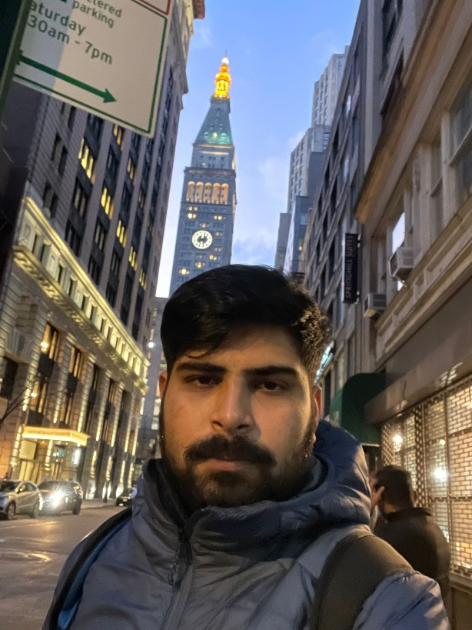
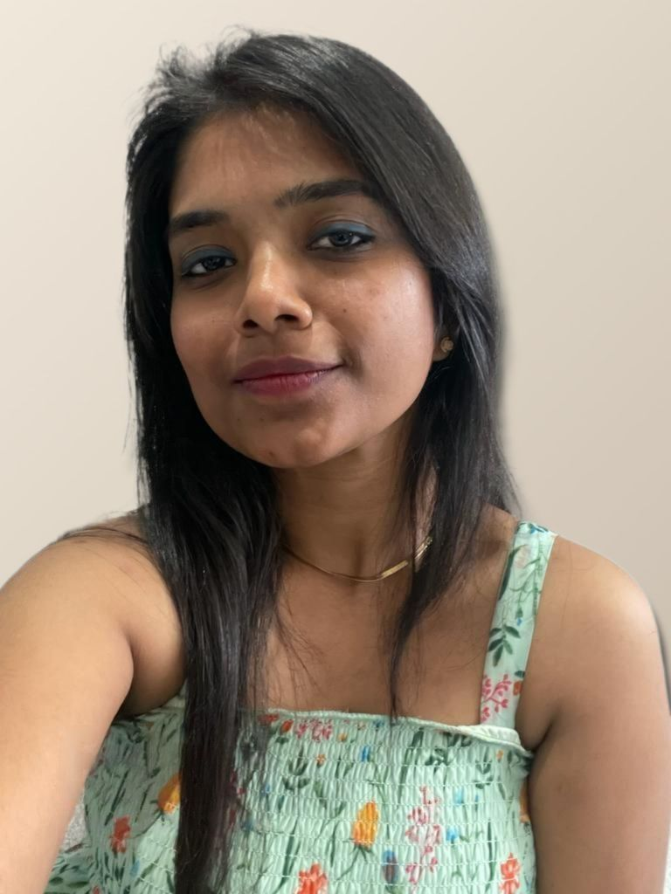

Team Introduction
Shivansh Tomar Developer
Mounika Thalla
Project Manager Quality Analyst
Jigar Shah
Developer

Slide 4
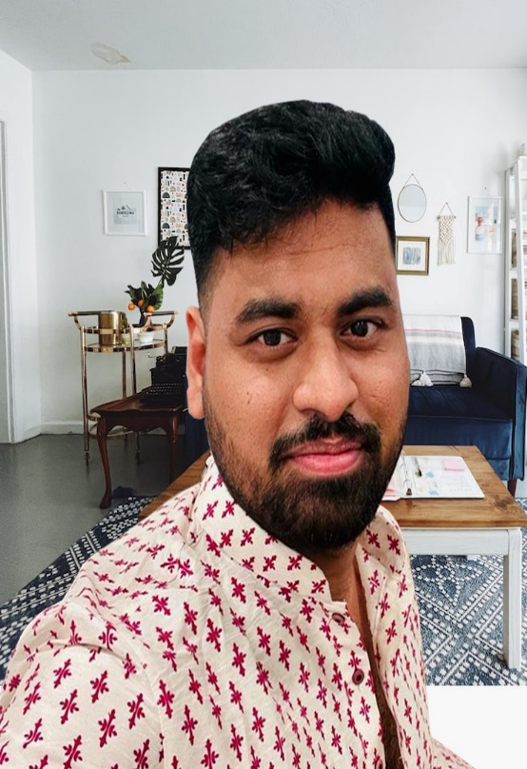


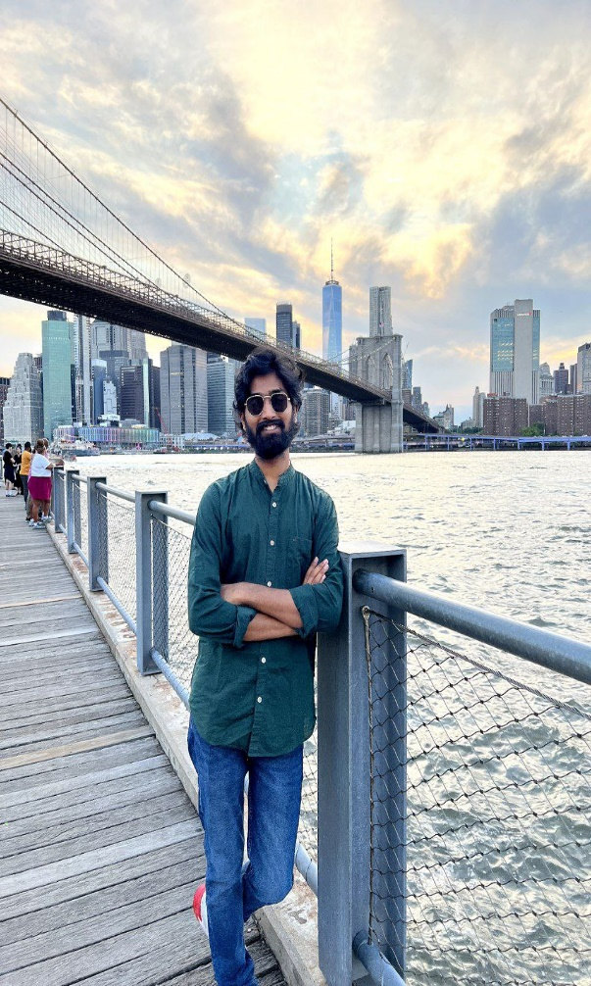
Team Introduction
Kuldeep Raj Kaluvala
Developer
Bindhu Valishetti Developer
Nikhil Kesireddy
Business Analyst & QA
Sai Teja Koribilli
Scrum Master & DBA

Slide 5
Improvements made from Professor's Feedback
According to the feedback given by the professor, the improvements we made were pertained to the topics such as:
Problem statement
Personas,
Introduction to the team and their roles &
Retrospective.

Slide 6
Problem Statement
Managing the massive volumes of patient related data is exhausting.
Absence of supply management system.
Inefficiency and errors in data sharing.
Patients who don’t have access to a healthcare center.
Lack of transparency.

Slide 7
Project Description
The project Hospital Management System includes patient registration, data storage in the system, and computerized billing in the pharmacy and labs.
The web-application has the capability of assigning a unique id to each patient and automatically storing the details of each patient and staff member.
It has a search function to determine the current status of each room. Using the id, the user can look up a doctor's availability and patient information.

Slide 8

Personas
Doctor
Tori is a young doctor of age 34 who is working at New York Health Center.
She has 30 to 40 appointments with patients everyday.
It is very hard to keep track of the appointment details and other information related to patient.
So by using hospital manage system, she can access the details of appointments easily.

Slide 9
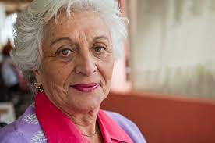
Personas
Patient
Mary is 81 years old woman who is suffering from auto-immune disease, lyme disease and asthma. Lives in Aurburn in Alabama, US.
Undergoes checkup every month ,But every time she has to fill appointment form and wait hours for the doctor.
By using Hospital management system, she can fill her details once and book appointment with doctor easily.

Slide 10

Personas
Admin
William is a admin of Texas State Hospital. He is 34 years old who plays a key role in the hospital management.
He manages the scheduling and appointments of doctors.
He plans departmental activities, evaluate doctors and other hospital employees, patient services.
He creates and deletes all the roles.
By using hospital system management, he can organize the above activities easily.

Slide 11
MVP
AUTHENTICATION:-
CREATE ACCOUNT/REGISTER :- When the new registers the system sends an authentication mail to the registered email-id.
LOGIN/LOGOUT:-Every user can LOGIN and LOGOUT of the system.
When a registered user forgets his/her password the system provides help in retrieving the password and create a new password for the registered user.

Slide 12
MVP
INVENTORY MANAGEMENT:-
Admin has access to the inventory so that he/she can order the products according to the need of the hospital.
Doctors and staff also have access to browse the inventory details so that they can request for products.
Doctor can see if they have specific article to conduct a procedure or can request the Admin for the article when they need.

Slide 13
MVP
ACCESS TO RECORDS:-
The Admin will have access to all records consisting of patient records, Doctor records and details and Inventory records. This will aid the Admin to run and serve the hospital.
The Doctor will have access to records of all patients registered under him/her helping him/her to give a proper consultation to the patient. The doctor will also be able to see the inventory records.
The patient will all the records from bill statement to medical history and medication prescribed by the doctor coming under his/her name.

Slide 14







Technologies used
Python
Jira
JavaScript
CSS

Slide 15


ARCHITECTURAL DIAGRAM

Slide 16
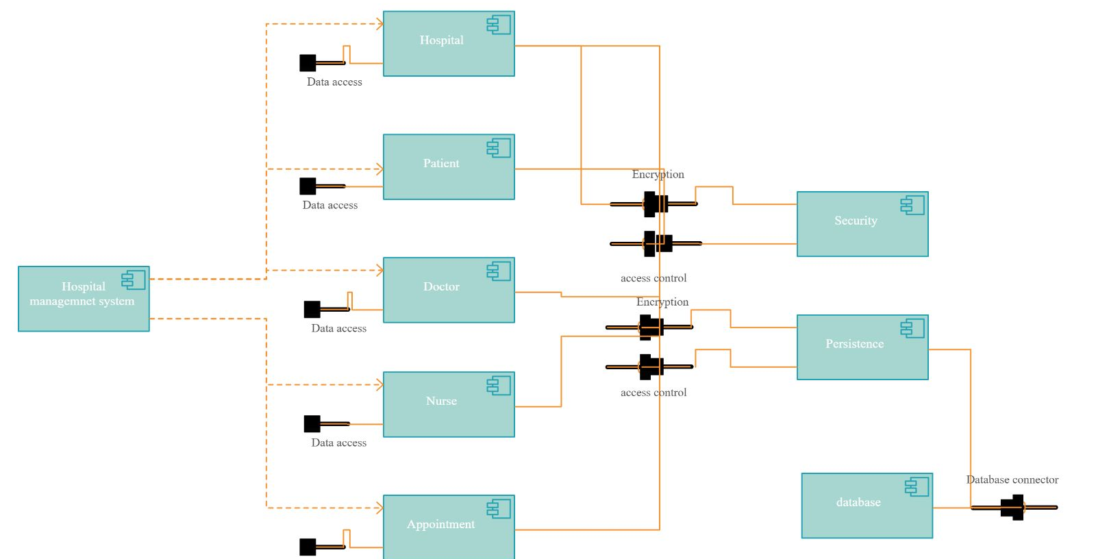

Slide 17
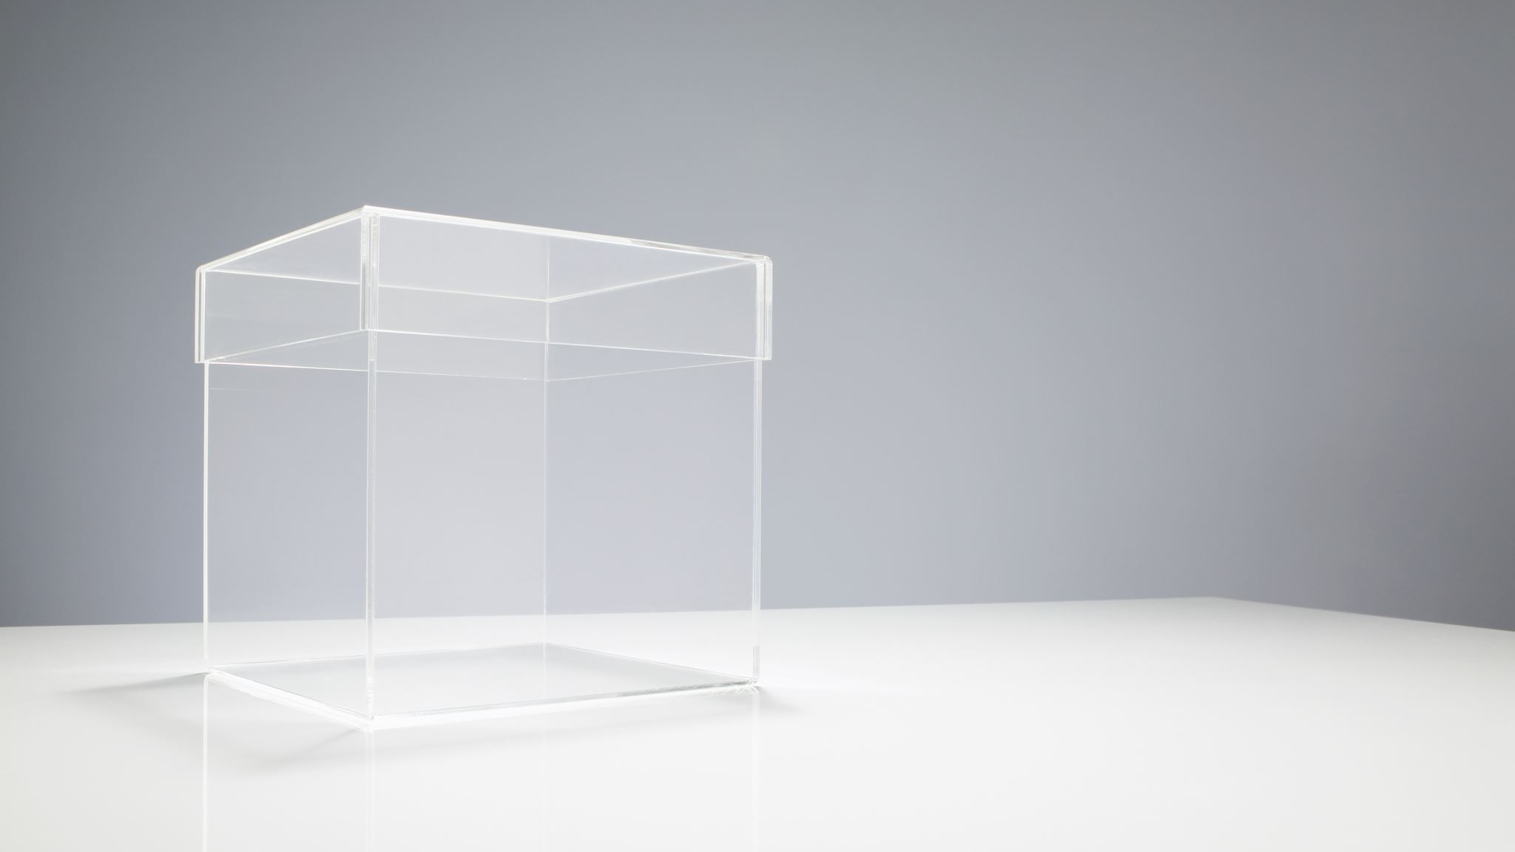
Product Backlog

Slide 18
Product Backlog
PB No. | Product Backlog
PB 1 | As an admin, I want to navigate to doctor/staff/nurse section to check the log-in time whether every doctor/nurse/staff is attending the hospital on time.
PB 2 | As an admin/patient/doctor, I want to return to the homepage so that I can re-read the application mission statement,disclaimer,etc
PB 3 | As an admin, I want to navigate to the patient/doctor/staff section and see all the particulars of that person are shown on the application without any glitch.
PB 4 | As a doctor, I want to see my particulars/schedule/profile on the application without any errors.
PB 5 | As a user(patient), I want to confirm that my appointment with the doctor is set-up or no, so that I can have an idea about the appointment with the doctor.
PB 6 | As a user(patient), I want to submit my symptoms/previous history documents in the portal for assessment so that I may receive a accurate determination.
PB 7 | As an inventor, I want to know whether the supplies are as per the requirement or no, so that I can stock them.
PB 8 | As a pathologist, I want to know whether samples of the patient are correctly entered or no, so that there is no confusion with patient's details with others.
PB 9 | As an admin, I want to navigate to billing/supply section whether each billing is running smoothly and supply is available.
PB 10 | As a user, I want to know that I have reached the correct page to use CURA application so that I can be sure I am uploading my details to the correct portal.

Slide 19
User Stories - Admin
Id | As | I want | so that
1 | Admin | To add/delete/update a doctor/staff/patient profile. | I can manage the system accordingly.
2 | Admin | To see the schedule of the doctor and staff of the hospital. | I can pay a doctor and staff according to his/her service time.
3 | Admin | To see patient details and appointment history. | I can get an idea about patient’s activity on the system.

Slide 20
User Stories - Doctor
Id | As | I want | So that
4 | Doctor | To update my schedule and apply for leaves when needed. | I can have an idea of my schedule and leaves.
5 | Doctor | An option to cancel or reschedule an appointment. | I can notify the patients about the cancellation or rescheduling of an appointment.
6 |  | To update my profile. | To view my own profile and update it.
7 |  | To see the patient’s information. | I can get an idea about the patient's current health situation.

Slide 21
User Stories - Patient
Id | As | I want | So that
8 | Patient | An easy way to register. | I can have a hassle-free experience while creating my profile/account.
9 | Patient | Some information from helpdesk to resolve my doubts. | I can get an idea to solve my doubts.
10 | Patient | An option to search doctor’s profile and his research works. | I can easily find a particular doctor with a specific specialization.
11 | Patient | An option to download my prescription. | I can download the hardcopy of the prescription .

Slide 22
User Stories - Staff
Id | As | I want | So that
12 | Staff | To know the supply of the inventory, drugs, medical and surgical equipment's. | I can know the update and availability on the supply for the inventory, drugs, medical and surgical equipment's.
13 | Patient | To update the patient’s details in the portal. | I can update the patient’s profile on the portal so that patient can view their details at any time.

Slide 23
User Stories - Pathologist
Id | As | I want | So that
12 | Pathologist | To add/update the equipment details in the portal. | Admin can help me update the supply of the equipments in the hospital.
13 | Patient | To add/update the patient’s test details in the portal. | Patient can view his test results at any moment.

Slide 24
Acceptance Criteria - Admin
Id | As a | Acceptance Criteria
1 | Admin | a) I could be able to add/delete a doctor profile. b) I could be add necessary information in the doctor's profile. c) I could add a tag to a doctor's profile. d) I could delete a patient profile if needed.
2 | Admin | a) I could be able to see the total working hours a doctor spends on consulting patients. b) I could be able to see the doctor’s log-in and log-out.
3 | Admin | a) I could be able to see patient's information. b) I could check patient's total appointments scheduled.

Slide 25
Acceptance Criteria - Doctor
Id | As a | Acceptance Criteria
4 | Doctor | a) I could be able to see his profile and make necessary corrections if needed. b)I could see the necessary information of the patient. If there is an availability of previous prescriptions, doctor will be able to proceed further for any treatment or diagnosis. c) I could be able to give downloadable prescriptions to the patient.
5 | Doctor | a) If needed, I could be able to cancel an appointment (for a leave) at least prior 8 hours of the consultation scheduled. b) If the patient agrees, I could be able to reschedule an appointment.

Slide 26
Acceptance Criteria - Patient
Id | As a | Acceptance Criteria
6 | Patient | a)I could register in this system, providing some necessary information. b)The information can be changed anytime after creation of my profile. c)I have to produce some necessary information and prior documents about his health status.
7 |  | a) I could ask my questions or doubts to the help desk. b) After providing symptoms, the best suggestion will be given from the help desk. c) I could contact by email or conduct a virtual meeting with the desk if necessary.
8 |  | a) I could search for doctors' names with their rating rated by other patients. b)I could get the available time and date of the doctors will be in the search result. c) I could search a doctor by typing the disease name/tag or specialization field.
9 |  | a)As soon as the doctor provide the prescription, then I could be able to download the same.

Slide 27
Acceptance Criteria - Staff
Id | As a | Acceptance Criteria
6 | Staff | I could update the supply of the drugs, medical and surgical equipments in the hospital.
7 |  | I could see the patient details in the portal. I could be able to add the details of the patient and the medical supply added are of the same patient.

Slide 28
Acceptance Criteria - Pathologist
Id | As a | Acceptance Criteria
6 | Pathologist | a) I could be able to update the supply of the medical equipments in the hospital if necessary.
7 |  | a) I could update the details of the patient in the portal. b) I could able to update the test results of the patient.

Slide 29
Testcases
Test Scenario | Test cases | Test data | Expected output
Sign Up / Registration | 1) Click on signup button. 2) Filling all the fields. 3) Selecting username & password. 4) Submit the signup form. 5)Email validation. 6) Password validation. | abc@gmail.com abc123 | 1) Able to open Signup form. 2) Able to fill all the fields and if left empty, portal should raise error. 3) Able to choose unique username & strong password. 4) Able to submit the signup form after entering all fields and data sent to server. 5) If entered incorrect form of email, portal should raise the error 6) If password length is less than minimum length, portal should raise the error.

Slide 30
Testcases
Test Scenario | Test cases | Test data | Expected output
Sign In / Login | 1) Opening Login Form 2) User Login 3) User Forgot Password 4)Submit the login Form | abc@gmail.com abc123 | 1) Able to open login page. 2) If entered incorrect username or password, portal should raise the error. 3) If incorrect password entered, portal should raise error and give reset option. 4) Able to submit the form and get logged in.

Slide 31
Sprint Backlog

Slide 32
Sprint Backlog
Key | Summary | Status
SB-1 | Create mock-up designs | Done
SB-2 | Research React JS and MongoDB Framework | Done
SB-3 | Complete Deliverable 2 Powerpoint Presentation | Done
SB-4 | Complete User Stories | Done
SB-5 | Complete Test Cases | Done
SB-6 | Complete Acceptance Criteria | Done
SB-7 | MVP Demo | To-do
SB-8 | Develop front-end page and testing | To-do
SB-9 | Develop back-end page and testing | To-do
SB-10 | Finish development of front-end UI | To-do
SB-11 | Develop API and testing in Cucumber | To-do

Slide 33
Stories
Completed
Incomplete
As a patient, I want to register and sign in successfully, so that I can store all my account details.
As a patient, I want to book an appointment.
As a doctor, I want to go-through the appointments list.
As an admin, I should be able to access and manage all the data and modify according to requirements.
As an admin, I should be able to create new bill payment services and authenticate them.
As a patient, I want to login and use forget password link, if necessary.

Slide 34
Metrics
Team velocity
Burndown charts

Slide 35
Team velocity
Sprint.no | No. of tasks
1 | 10 .
2 | 17 20
X-axis : Sprint
Y-axis : No. of days taken

Slide 36
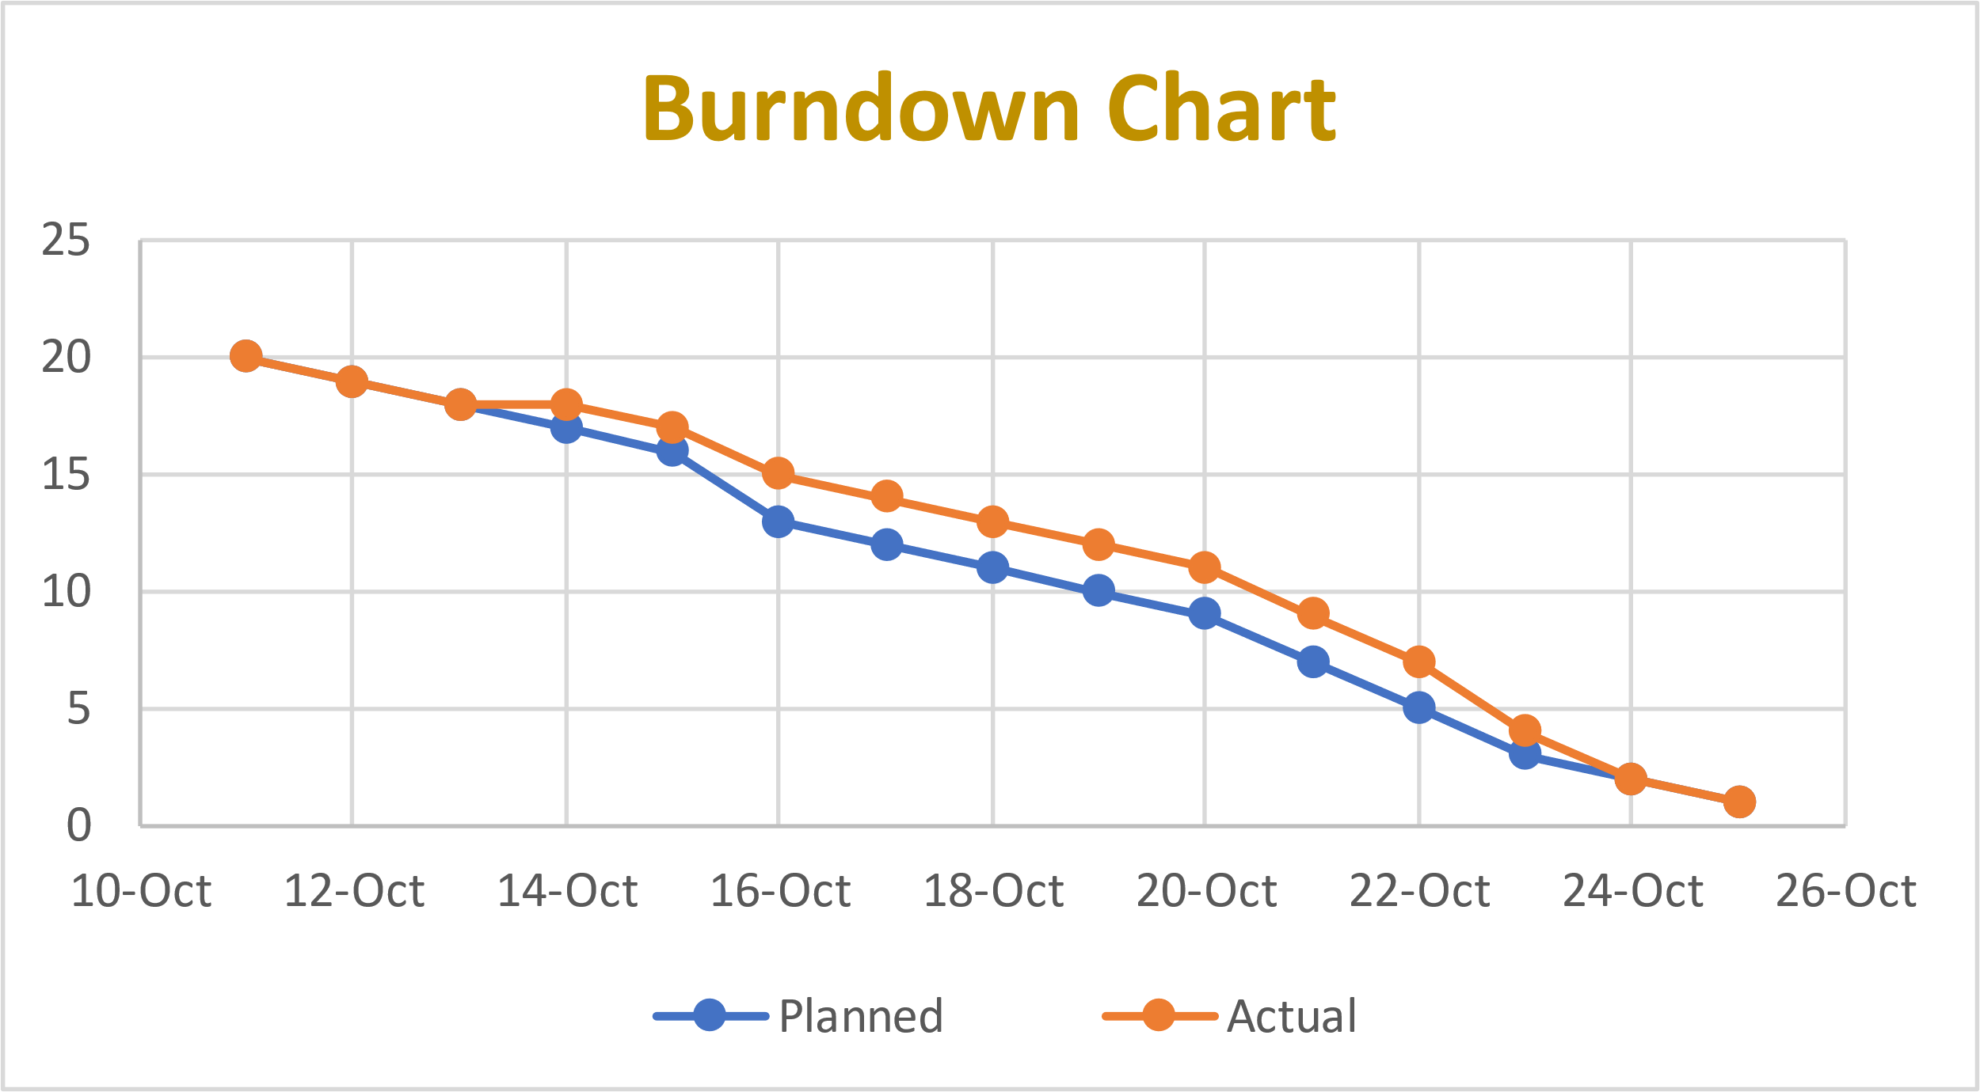

Slide 37
Burndown chart
Tasks | Calender Days | Planned | Actual
MVP | 11-Oct | 20 | 20
Technolgies to be used | 12-Oct | 19 | 19
Architectural diagram | 13-Oct | 18 | 18
Product Backlog | 14-Oct | 17 | 18
Product Backlog | 15-Oct | 16 | 17
User stories with acceptance criteria | 16-Oct | 13 | 15
User stories with acceptance criteria | 17-Oct | 12 | 14
Sprint Backlog | 18-Oct | 11 | 13
Test cases | 19-Oct | 10 | 12
Test cases | 20-Oct | 9 | 11
Stories completed | 21-Oct | 7 | 9
Stories not completed | 22-Oct | 5 | 7
Stories or tasks committed | 23-Oct | 3 | 4
Metrics | 24-Oct | 2 | 2
Burndown charts | 25-Oct | 1 | 1

Slide 38
Mock-up design

Slide 39
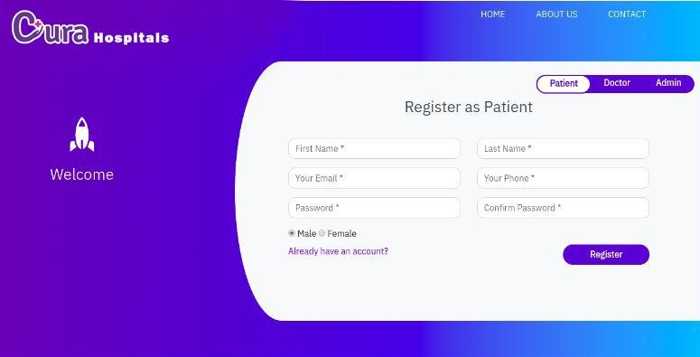
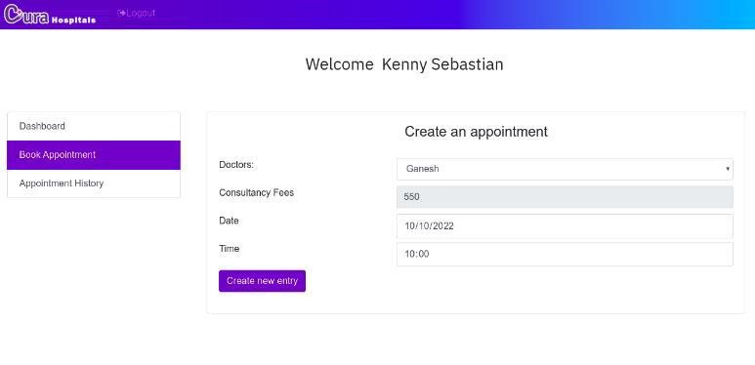
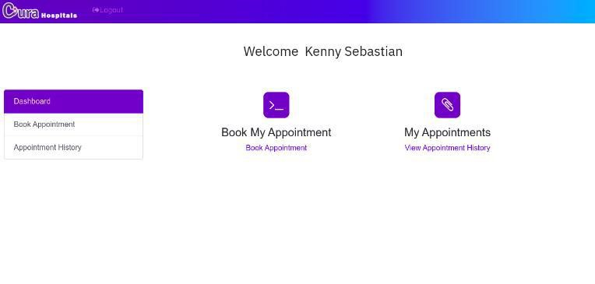
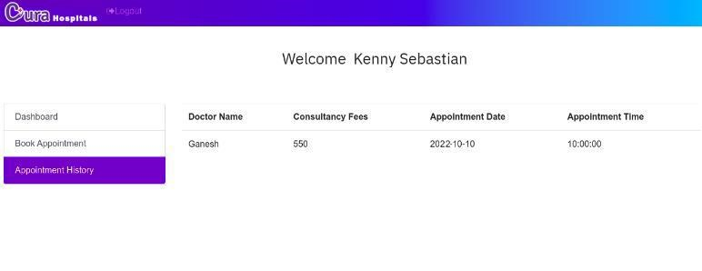

Slide 40
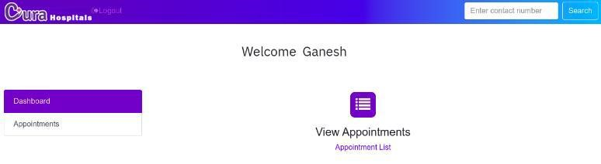
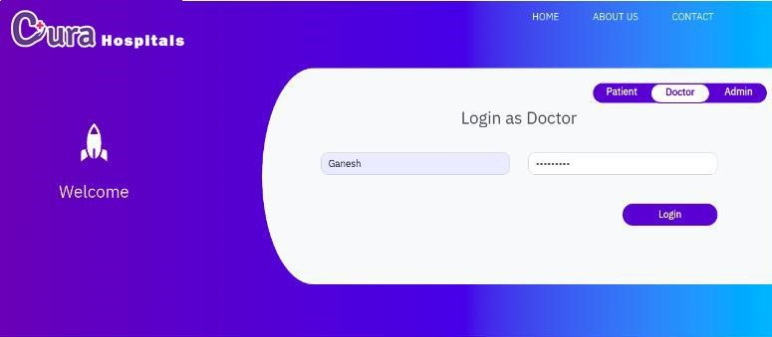
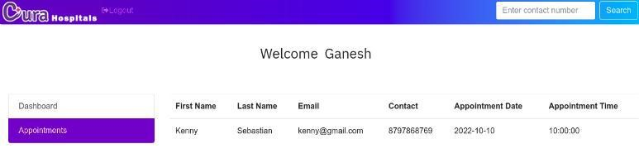

Slide 41
Retrospectives
What went well?
Team improved in working and involving to task which was assigned to them.
What need to be improved?
Helping and tracking progress of each other’s work

Slide 42
Retrospectives
What next?
Although we had idea, we need to more research about the front and backend technologies to be used in our project
What went well?
To develop login page, we specifically worked on react js

Slide 43
Wikilink
https://github.com/SaiTejjj/HMS/wiki/CURA---HMS

Slide 44

Thank you

